Slide 1
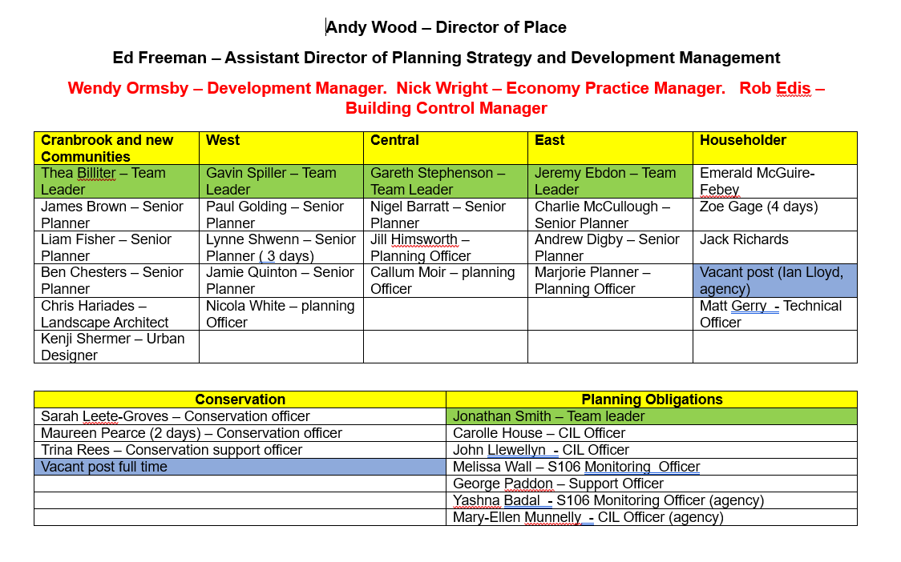

Slide 2
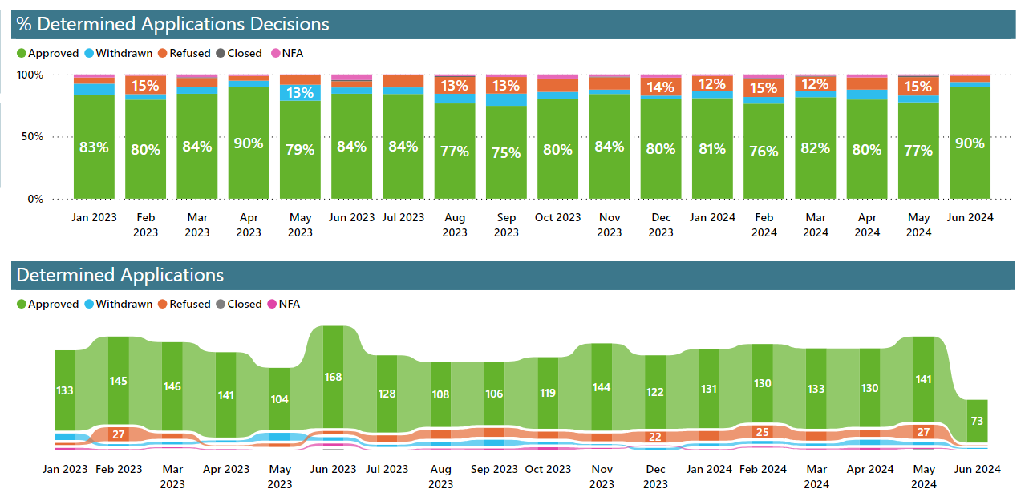

Slide 3
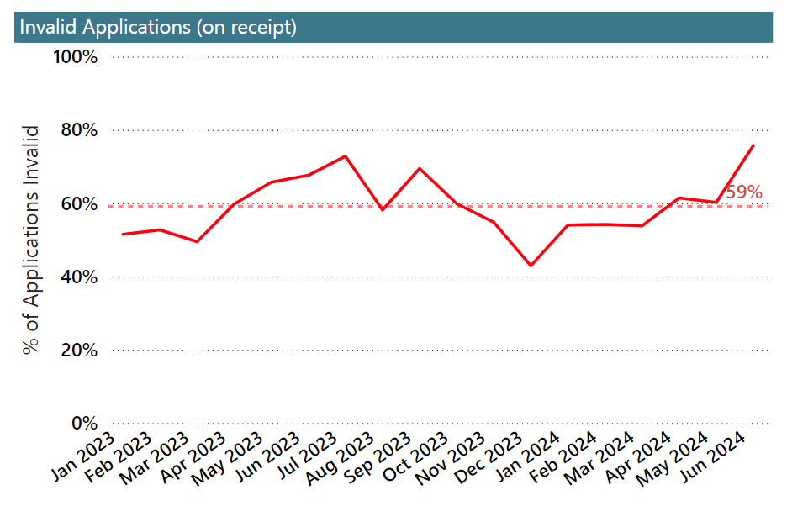

Slide 4
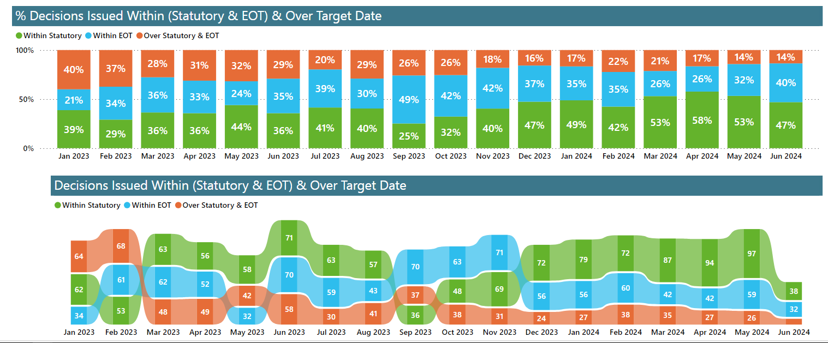

Slide 5

Ecology/BNG
Biodiversity Net Gain: Processes in review for Habitat Banks and discharge of Biodiversity Gain Condition – Modal informatives
Exacom software purchased – training needed
Ecology web site updates:
https://eastdevon.gov.uk/planning/planning-and-biodiversity/
https://eastdevon.gov.uk/planning/phosphates-on-the-river-axe/

