Slide 1

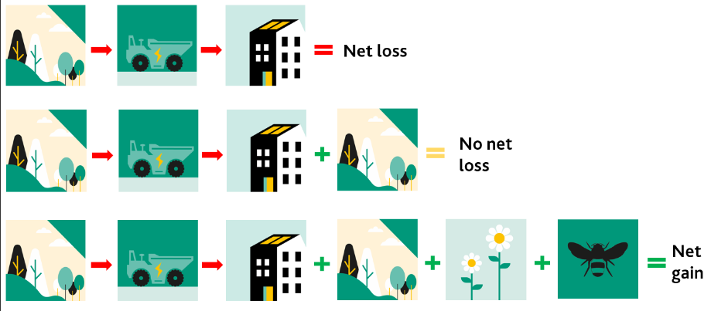
Biodiversity Net Gain (BNG)
An Introduction
William Dommett MSc MCIEEM – District Ecologist

Slide 2
Introduction – What is Biodiversity Net Gain (BNG)
Biodiversity net gain (BNG) is an approach to development, and/or land management, that aims to leave the natural environment in a measurably better state than it was beforehand
BNG delivers measurable improvements for biodiversity by creating or enhancing habitats in association with development
BNG can be achieved on-site, off-site or through a combination of on-site and off-site measures
Notes:
The word ‘biodiversity’ comes from the term ‘biological diversity’. It refers to the variety of all living organisms, including animals, insects, plants, bacteria and fungi.
BNG is achieved if biodiversity increases or is enhanced in comparison with a clearly defined reference scenario. In the context of development planning, BNG means going further than compensating for biodiversity loss where development impacts cannot be avoided or mitigated.

Slide 3
What is Biodiversity Net Gain (BNG)?
Notes:
The word ‘biodiversity’ comes from the term ‘biological diversity’. It refers to the variety of all living organisms, including animals, insects, plants, bacteria and fungi.
BNG is achieved if biodiversity increases or is enhanced in comparison with a clearly defined reference scenario. In the context of development planning, BNG means going further than compensating for biodiversity loss where development impacts cannot be avoided or mitigated.

Slide 4
BNG – Existing duties to ‘enhance’
BNG is not a new concept.
National Planning Policy Framework (NPPF) para 174(d):
  174. Planning policies and decisions should contribute to and enhance the natural and local environment by:
  (d) minimising impacts on and providing net gains for biodiversity, including by establishing coherent ecological networks that are more resilient to current and future pressures;
Notes:
Environment Act 2021 – Local authorities (LAs) new biodiversity duty (amended s40 NERC 2006, in force 1 Jan 2023): LPA must from time to time consider what action it can take to further the conservation and enhancement of biodiversity. Previously LPAs only had to have ‘regard’, which is a weaker statement.

Slide 5
BNG – Existing duties to ‘enhance’
Natural Environment and Rural Communities (NERC) Act 2006:
  40. Duty to conserve and enhance biodiversity
  (3)The action which may be taken by the authority to further the general biodiversity objective includes, in particular, action taken for the purpose of—
  (a)conserving, restoring or otherwise enhancing a population of a particular species, and
  (b)conserving, restoring or otherwise enhancing a particular type of habitat.
Notes:
Environment Act 2021 – Local authorities (LAs) new biodiversity duty (amended s40 NERC 2006, in force 1 Jan 2023): LPA must from time to time consider what action it can take to further the conservation and enhancement of biodiversity. Previously LPAs only had to have ‘regard’, which is a weaker statement.

Slide 6
What is Mandatory Biodiversity Net Gain?
From November 2023 (date TBC) under the Environment Act 2021, all major planning permissions (10 or more dwellings) granted in England (with a few exemptions) will have to deliver at least 10% biodiversity net gain
The requirement is mandatory (not policy) and once enacted will modify the Town and County Planning Act (T&CPA)1990 with a new s90a and schedule 7A
The requirements for ‘Small Sites’ (<10 dwellings) will come into force from April 2024 (date TBC)
There is still secondary legislation and guidance to be released by the government so some details are not fully confirmed
Notes:
When does this start?
• Legislation says: Planning permissions granted after start date (X November 2023)
• Defra says: Planning applications made after start date (X November 2023)- most likely.

Slide 7
BNG – what it applies to
Applies to all land development to low water mark, except permitted development.
Does include:
  Brownfield development
  Change of use applications
  Temporary permissions
  “Small sites”
    Residential: <10 dwellings on <1ha site OR unknown number on <0.5ha site;
    Non-residential: floorspace <1000 m² OR < 1ha site

Slide 8
BNG – does not include
Does not include
  Permitted development
  Marine development
  Where a site’s baseline biodiversity score is zero (e.g., hardstanding, sealed surfaces)
Where temporary impacts will be restored within two years (under the NE metric v4.0)

Slide 9
BNG – does not include
Secondary legislation (not yet published) to specify further exemptions:
  “De minimis” habitat area threshold of 25 m² / 5 m (linear habitat)
  Householder applications
  Biodiversity gain sites, e.g., to create biodiverse habitats such as ponds, woodland etc.
  Small scale self-build and custom housebuilding (TBC)
  Irreplaceable habitats
These could still be subject to local plan BNG policy
Notes:
Draft Policy 87- Biodiversity Net Gain of the East Devon Local Plan 2020 – 2040 seeks the implementation of at least 20% BNG for all sites which are non excempt.
20% justification
East Devon contains a high diversity of ecologically important sites and habitats, however, many of these are sporadic and small, and exist in isolation without connection to other similar habitats. In order for the council to further the biodiversity objective, make progress towards halting biodiversity loss and aid biodiversity recovery in the district, East Devon District Council recognise the need to take action to implement the recommendations of the Lawton Report (increasing the area of natural/semi-natural habitats, improving the quality of existing habitats, and connecting isolated habitats. Biodiversity net gain provides a mechanism to achieve some of these goals.
Biodiversity net gain is a new system. Habitats are to be secured and maintained for at least 30 years through legal obligations, in order to meet a target habitat type and condition. Delivery and long-term security of habitats is not yet fully tested, which leads to uncertainty in outcomes. Delivery and aftercare of compensatory habitat is complex, both in terms of physical management and legal obligations. When uncertainty exists within environmental decision making, the precautionary principle should be applied.
The DEFRA Evidence Base and Impact Assessment Report for biodiversity net gain (2017) made an assessment of the potential cost of biodiversity net gain to government and developers. Table 27 (page 60) estimates that increasing the net gain percentage to 20% from 10% results in an increase in initial biodiversity net gain delivery cost of ~18%, and a corresponding 29% increase in the area (ha) of habitats created.
Swale borough Council used the DEFRA viability study to evidence that 10% BNG costs developers approximately £948/dwelling, and 20% costs approximately £180/dwelling more. The majority of biodiversity net gain cost to developers is within the first 10% of delivery, with reduced cost to deliver additional net gain.

Slide 10
New ‘general planning condition’
New statutory “general planning condition” inserted into the T&CPA 1990
Summary: No commencement of development until a Biodiversity Gain Plan (BGP) has been submitted to and approved by the Local Planning Authority (LPA)
Applies to every planning permission granted
Condition cannot be removed, modified or disapplied
Notes:
General condition is one that exists in legislation - not written in decision notice..
Condition does not require implementation of the BNG plan.

Slide 11
Biodiversity Gain Plan
Developer must deliver a “Biodiversity Gain Plan”
The plan must show biodiversity gain of “at least 10%” between:
  1. “pre-development biodiversity value of onsite habitats”; and
  2. “biodiversity value attributable to the development”
The plan must include a completed statutory approved metric demonstrating the calculations and minimum 10% gain
Development cannot commence until LPA has approved the Biodiversity Gain Plan

Slide 12
Biodiversity Gain Plan
The Biodiversity Metric 4.0 (current version) is an Excel based tool that use the type, condition, and area of habitats as a proxy for change in biodiversity from before to after a development, in terms of ‘Biodiversity Units’ (BUs).
The difficulty of enhancing an existing habitat or creating a new habitat, as well as the time taken to do so, are factored into the metric calculation.
In England, a development will need to show a minimum 10% increase in BUs, compared to the baseline, to demonstrate that BNG can be delivered.

Slide 13
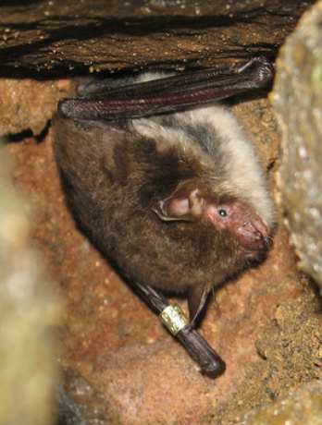
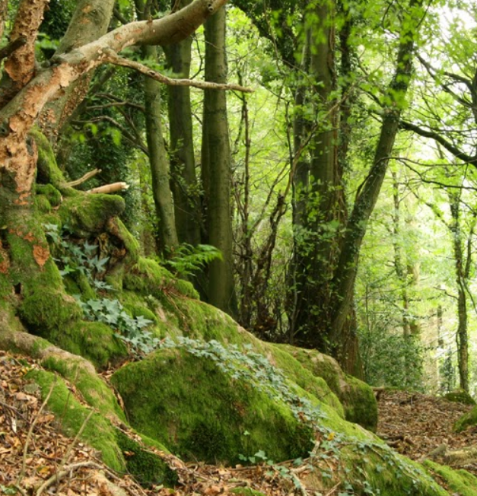
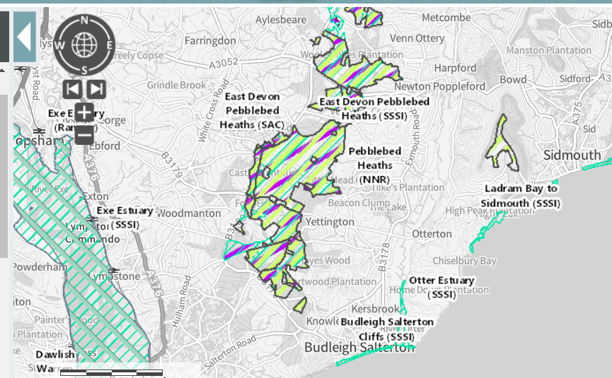
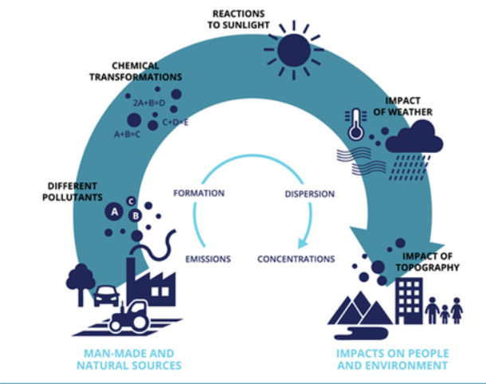

Slide 14
Biodiversity Gain Plan
It is important to remember that BUs derived using the metric are only a proxy for biodiversity and additional ecological data must be used to design BNG based on sound ecological practices
The metric uses habitats as a proxy i.e. does not address:
  Species
  Protected sites
  Irreplaceable habitats
  Indirect impacts
  Cumulative / in combination impacts

Slide 15
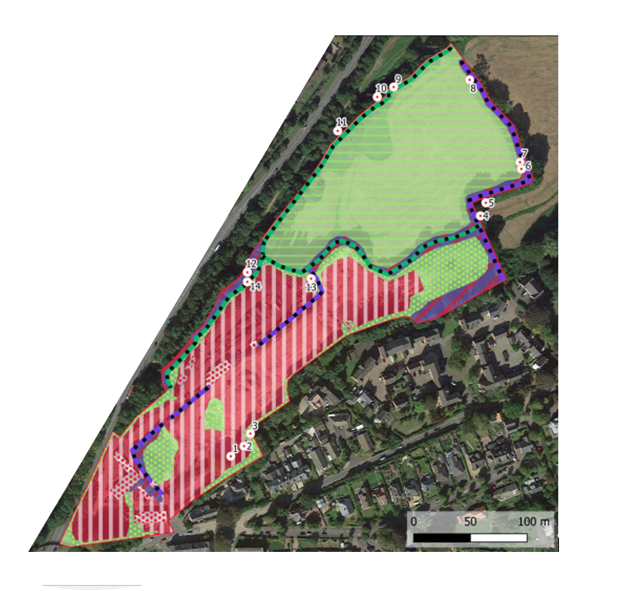
Baseline habitat value
Developer measures pre-development biodiversity value of onsite habitats, i.e., within the redline planning boundary
  To be measured within 12 months of an application (or otherwise specified)
  Need to be undertaken by a ‘competent’ ecologist using the UK Habitats Classification and NE habitat condition assessment
There are measures to prevent deliberate downgrading of habitat values prior to submitting planning applications
  ‘Anti-trashing’ measures

Slide 16
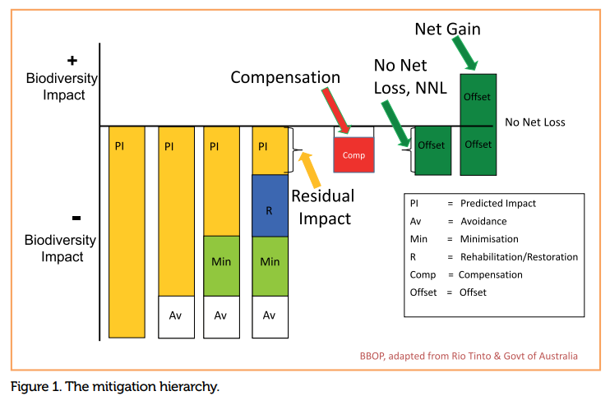
Mitigation hierarchy
Notes:
The Environment Act includes provision to exempt irreplaceable habitats from the mandatory BNG requirement. Secondary legislation will set out a clear definition of irreplaceable habitat and list of habitat types to be considered irreplaceable.

Slide 17
Mitigation hierarchy
Biodiversity net gain in England is underpinned by the mitigation hierarchy, which is set out in the National Planning Policy Framework
Information outlining how the mitigation hierarchy has been adhered to, including evidence of the steps taken to avoid and/or minimise adverse biodiversity impacts, must be included within the biodiversity gain plan
Financial cost is not adequate reasoning for failing to ‘avoid’ or ‘minimise’ negative effects
Notes:
This outlines a sequential approach to addressing potential harm to biodiversity in determining planning applications. It states avoidance should be prioritised, before mitigation measures, and finally compensation.
AVOID
To evade or reduce biodiversity impacts through site selection and layout.
Project proposals must give the highest priority to ‘avoidance’ strategies as the primary approach in order to adhere to the mitigation hierarchy; vital
to delivering cost effective additionally.
MINIMISE
To take measures to reduce the duration, intensity and/or extent of impacts to biodiversity.
Where avoidance is not feasible, it is essential to minimize any potential negative impacts by modifying the project design and strategy to the fullest extent
possible. All sensitive habitats must be avoided at all costs.
MITIGATE
The condition of on-site habitat or an affected area is improved and/or protected. Including enhance, restore, or regenerate biodiversity
on-site.
All non-avoidable ecological damage must be adequately replaced/ mitigated for with the guidance and expertise of a trained ecologist.
Essential is to provide a strong evidence-case demonstrating why avoidance and mitigation strategies were not viable options.
OFFSET OR COMPENSATE
Compensating for any residual, adverse, unavoidable impacts after full implementation: Onsite or offsite.
The final resort after all other options have been exhausted as the most expensive, complex, and high-risk approach.

Slide 18

Mitigation hierarchy – avoidance
To evade or reduce biodiversity impacts through site selection and layout
Project proposals must give the highest priority to ‘avoidance’ strategies as the primary approach in order to adhere to the mitigation hierarchy
Examples:
  Site selection
  Retention of valuable habitat features, e.g., woodland.
Early engagement with the process is recommended, i.e., prior to site design
Notes:
AVOID
Avoidance is the initial step in the hierarchy, and often the easiest, cheapest and most effective way of reducing potential impacts. It requires biodiversity to be considered in the early stages of a project.
The most effective avoidance mechanisms can be achieved by pr-eapplication engagement with an ecologist and/or local planning authority to identify the surveys needed to be undertaken, and engage key local biodiversity stakeholders.
Examples: Site selection or location on an alternative site with less harmful impacts, using relevant data, for example:
• referring to local nature recovery networks and local biodiversity strategies.
• using other spatial mapping tools such as Defra’s MAGIC tool;
• consulting local environmental records centres.
• carrying out an Ecological Assessment or Preliminary Ecological
Appraisal (if required) and associated habitat/species or walkover surveys; with the assistance of a trained ecologist.
• baselining potential sites using the metric.
• conducting a BNG Feasibility Report using CIEEM best practice.
• timing construction sensitively to minimize disturbance.
• engaging an ecological consultant at site selection stage to provide constraints/opportunities analysis at an early stage.
Impacts can also be avoided by retaining ecological receptors on site, but outside of the construction area. This can aid BNG by retaining the habitats of value and providing a potential opportunity for enhancement of those areas of value.

Slide 19
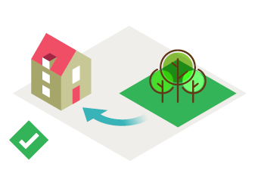
Mitigation hierarchy – minimise
To take measures to reduce the duration, intensity and/or extent of impacts to biodiversity
Where avoidance is not feasible, it is essential to minimize any potential negative impacts by modifying the project design and strategy to the fullest extent
Examples:
  Indicate retained vegetation e.g. hedgerows and existing trees;
  Limiting the size of the site / protecting key areas;
  Sensitive landscape design in line with industry best practice e.g. CIEEM BNG
Notes:
This outlines a sequential approach to addressing potential harm to biodiversity in determining planning applications. It states avoidance should be prioritised, before mitigation measures, and finally compensation.
AVOID
To evade or reduce biodiversity impacts through site selection and layout.
Project proposals must give the highest priority to ‘avoidance’ strategies as the primary approach in order to adhere to the mitigation hierarchy; vital
to delivering cost effective additionally.
MINIMISE
To take measures to reduce the duration, intensity and/or extent of impacts to biodiversity.
Where avoidance is not feasible, it is essential to minimize any potential negative impacts by modifying the project design and strategy to the fullest extent
possible. All sensitive habitats must be avoided at all costs.
MITIGATE
The condition of on-site habitat or an affected area is improved and/or protected. Including enhance, restore, or regenerate biodiversity
on-site.
All non-avoidable ecological damage must be adequately replaced/ mitigated for with the guidance and expertise of a trained ecologist.
Essential is to provide a strong evidence-case demonstrating why avoidance and mitigation strategies were not viable options.
OFFSET OR COMPENSATE
Compensating for any residual, adverse, unavoidable impacts after full implementation: Onsite or offsite.
The final resort after all other options have been exhausted as the most expensive, complex, and high-risk approach.

Slide 20
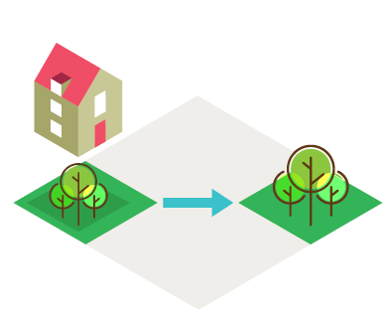
Mitigation hierarchy – mitigate
The condition of on-site habitat or an affected area is improved and/or protected. Including enhance, restore, or regenerate biodiversity on-site
All non-avoidable ecological damage must be adequately replaced/ mitigated for with the guidance and expertise of a trained ecologist
Examples:
  Replanting, timing works
  Redesigning aspects of the site to reduce the impacts (such as lighting).
Notes:
This outlines a sequential approach to addressing potential harm to biodiversity in determining planning applications. It states avoidance should be prioritised, before mitigation measures, and finally compensation.
AVOID
To evade or reduce biodiversity impacts through site selection and layout.
Project proposals must give the highest priority to ‘avoidance’ strategies as the primary approach in order to adhere to the mitigation hierarchy; vital
to delivering cost effective additionally.
MINIMISE
To take measures to reduce the duration, intensity and/or extent of impacts to biodiversity.
Where avoidance is not feasible, it is essential to minimize any potential negative impacts by modifying the project design and strategy to the fullest extent
possible. All sensitive habitats must be avoided at all costs.
MITIGATE
The condition of on-site habitat or an affected area is improved and/or protected. Including enhance, restore, or regenerate biodiversity
on-site.
All non-avoidable ecological damage must be adequately replaced/ mitigated for with the guidance and expertise of a trained ecologist.
Essential is to provide a strong evidence-case demonstrating why avoidance and mitigation strategies were not viable options.
OFFSET OR COMPENSATE
Compensating for any residual, adverse, unavoidable impacts after full implementation: Onsite or offsite.
The final resort after all other options have been exhausted as the most expensive, complex, and high-risk approach.

Slide 21
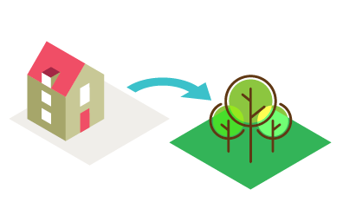
Mitigation hierarchy – compensate or offset
Compensating for any residual, adverse, unavoidable impacts after full implementation: onsite or offsite
The final resort after all other options have been exhausted as the most expensive, complex, and high-risk approach
Examples:
  Using the biodiversity net gain offsetting mechanisms, including through the creation or enhancement of off-site habitats, either on owned land, by purchasing biodiversity units on the market, or statutory credits.
Notes:
This outlines a sequential approach to addressing potential harm to biodiversity in determining planning applications. It states avoidance should be prioritised, before mitigation measures, and finally compensation.
AVOID
To evade or reduce biodiversity impacts through site selection and layout.
Project proposals must give the highest priority to ‘avoidance’ strategies as the primary approach in order to adhere to the mitigation hierarchy; vital
to delivering cost effective additionally.
MINIMISE
To take measures to reduce the duration, intensity and/or extent of impacts to biodiversity.
Where avoidance is not feasible, it is essential to minimize any potential negative impacts by modifying the project design and strategy to the fullest extent
possible. All sensitive habitats must be avoided at all costs.
MITIGATE
The condition of on-site habitat or an affected area is improved and/or protected. Including enhance, restore, or regenerate biodiversity
on-site.
All non-avoidable ecological damage must be adequately replaced/ mitigated for with the guidance and expertise of a trained ecologist.
Essential is to provide a strong evidence-case demonstrating why avoidance and mitigation strategies were not viable options.
OFFSET OR COMPENSATE
Compensating for any residual, adverse, unavoidable impacts after full implementation: Onsite or offsite.
The final resort after all other options have been exhausted as the most expensive, complex, and high-risk approach.

Slide 22
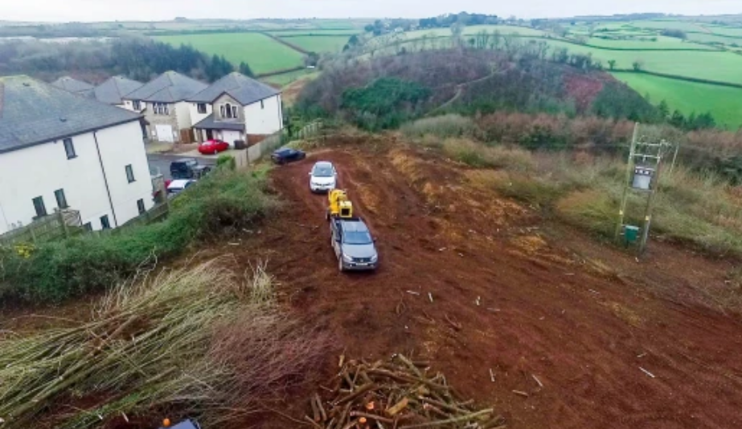
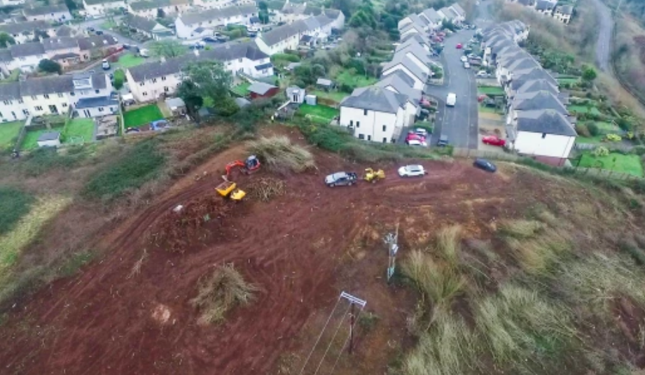
Anti trashing
Notes:
Property developer 'chops down wood before getting planning permission' | Metro News

Slide 23
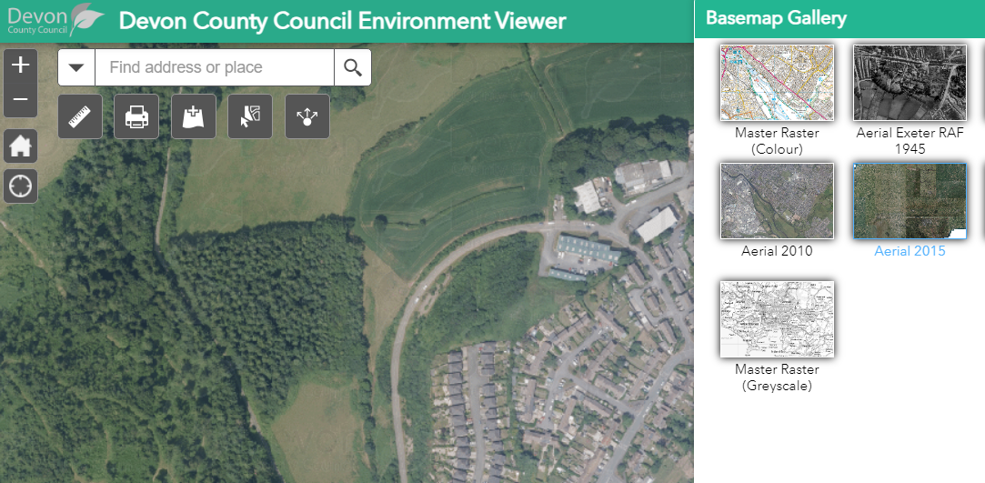
Anti trashing

Slide 24
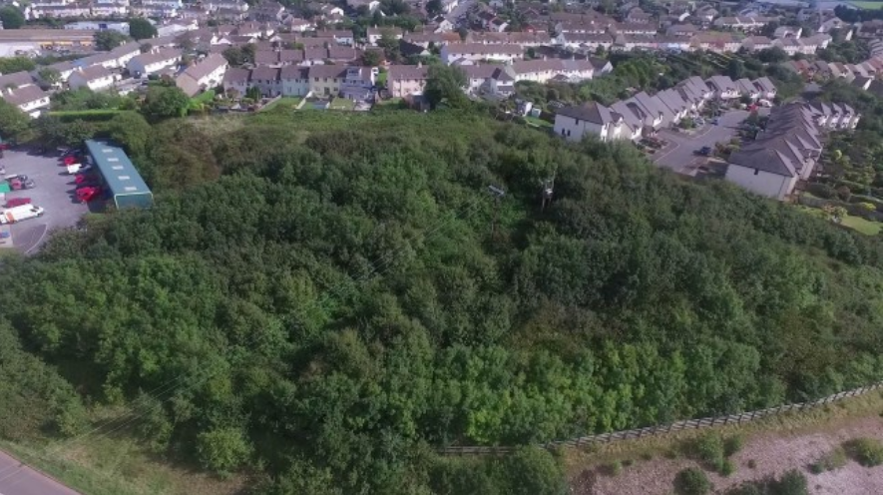
Anti trashing

Slide 25
Anti trashing
The LPA will check if correct pre-development onsite value is being declared in the Biodiversity Gain Plan
Any activities on / after 30 January 2020 that have contributed to the downgrading of a sites biodiversity value, e.g., vegetation clearance, will not be accepted as the baseline value for the site
  This includes if a site is ‘trashed’ and then sold on
  The pre-development onsite value is the value immediately before site clearance will be used
    The pre-trashing value will assume any habitats were in ‘good’ condition
Notes:
Anti trashing is not a criminal offence unless other wildlife breach's are made, e.g., destruction of a bat roost, killing or injury of birds etc.
There is already an existing requirement under BS 42020:2013 to consider any pre-planning activities to ‘reduce’ the value or a site
6.4.8 Where relevant, any report on survey activities should also include reference to any evidence of material events occurring on site, either before or after ecological surveys have been carried out, for example:
a) removal or management of vegetation, including trees;
b) alteration or loss of other biodiversity features, such as hedgerows, ponds,
ditches or buildings and features of value to protected species;
c) control of weeds or other species; and
d) cessation or reintroduction of grazing or mowing.
Such events should be described and the cause explained where known along
with the implications, if any, for the main findings of the ecological report.
NOTE 1 Such activities may include unexplained “clean up’” in derelict or old agricultural buildings or structural changes to an old building, e.g. installation of a new roof.
NOTE 2 Aerial photographs may be used to determine what a site was like before changes occurred.
It doesn't matter if land owner trashed it and sold it to developer - still need to take into account pre-trash value.
Environment Act 2021 - SCHEDULE 14 Biodiversity gain as condition of planning permission
(a)a person carries on activities on land on or after 30 January 2020 otherwise than in accordance with—
(i)planning permission, or
(ii)any other permission of a kind specified by the Secretary of State by regulations, and
(b)as a result of the activities the biodiversity value of the onsite habitat referred to in paragraph 5(1) is lower on the relevant date than it would otherwise have been,
the pre-development biodiversity value of the onsite habitat is to be taken to be its biodiversity value immediately before the carrying on of the activities.

Slide 26
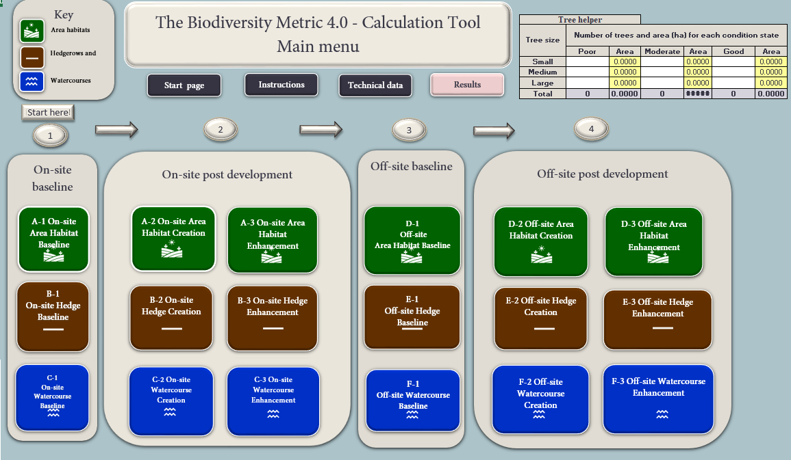
Biodiversity Metric 4.0

Slide 27

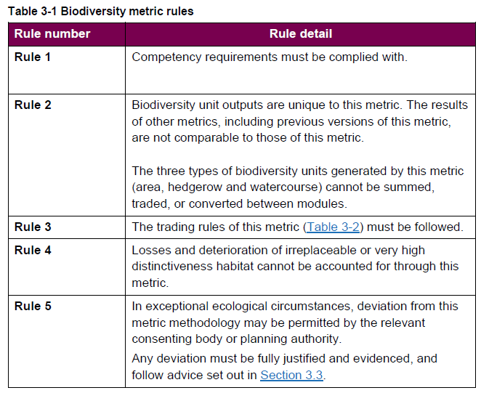
Biodiversity Metric 4.0 – The Rules!
Natural England (2023). The Biodiversity Metric 4.0 User Guide.

Slide 28
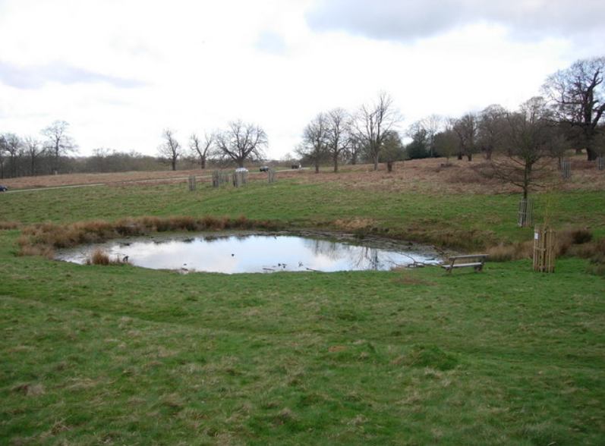
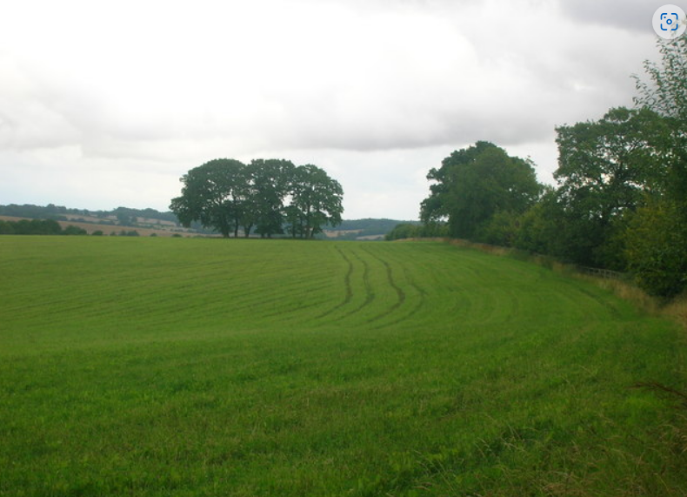
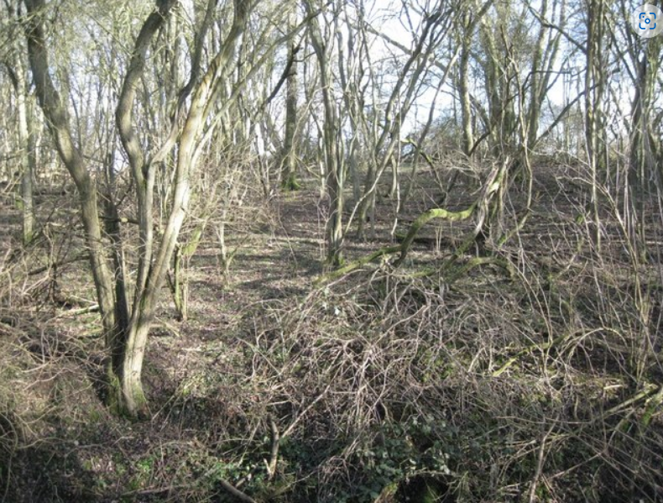
Baseline – Area habitats
Measured in hectares (Ha)
Notes:
Area habitats adjacent to hedgerows should be mapped to the centre line of the hedgerow (defined on OS maps by a black line).
• the footprint or canopy cover of a hedgerow or line of trees should not be subtracted from the total habitat area within a site
• the creation of hedgerows does not result in the loss of area habitat

Slide 29
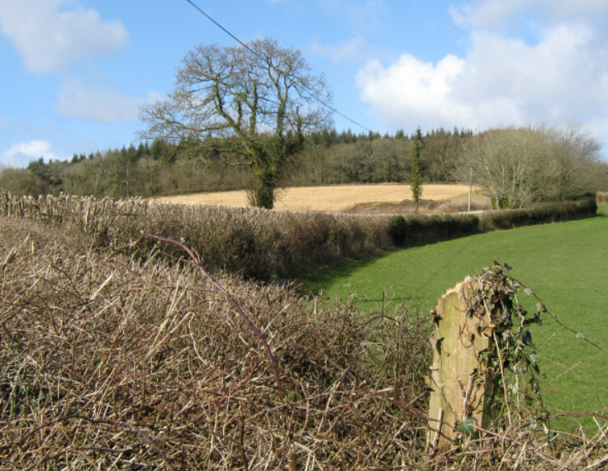
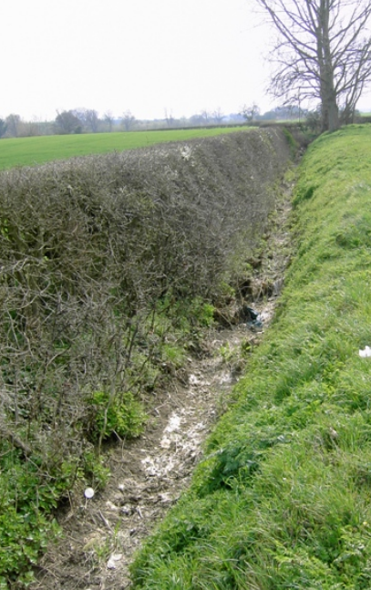
Baseline – Hedges and ditches
Measured in kilometres (Km)
Notes:
Recorded as a centre line measurement along the length of the feature

Slide 30
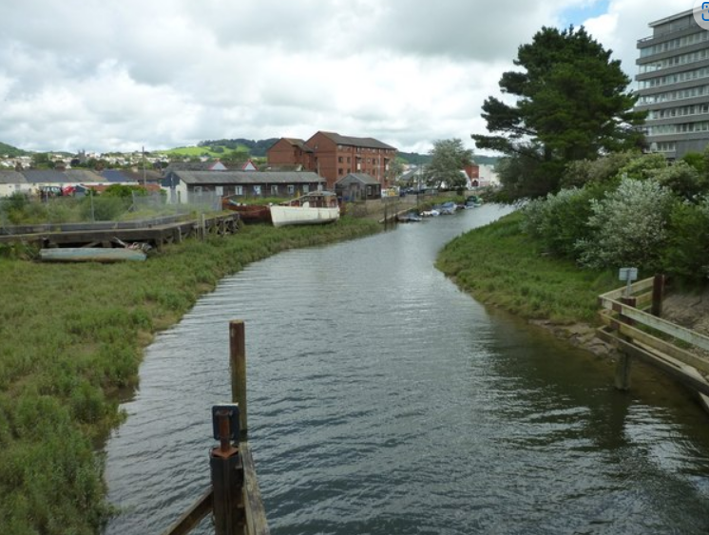
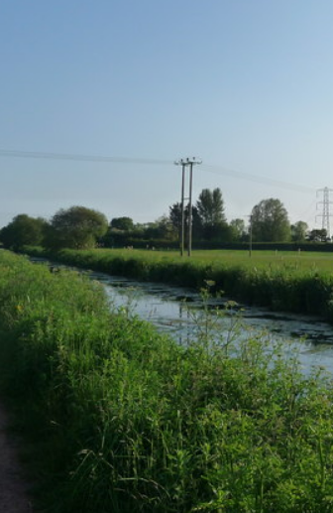
Baseline – Watercourses
Notes:
The watercourse unit module is applied to the following features:
• Priority rivers
• other rivers and streams
• canals
• ditches
• culverted sections of the above
The watercourse module includes an assessment of the riparian zone. If the site boundary crosses into the riparian zone, adjacent lengths of watercourse must be included within a metric assessment (Figure 10-1).

Slide 31
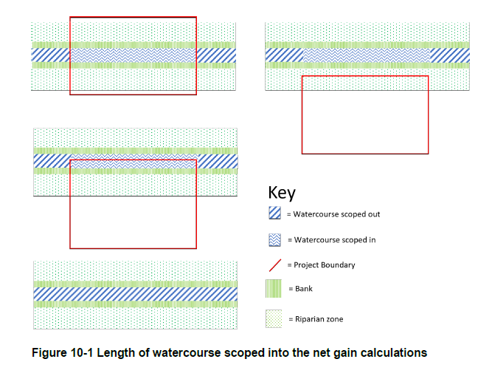
Baseline – Watercourses
Notes:
The watercourse module includes an assessment of the riparian zone. If the site boundary crosses into the riparian zone, adjacent lengths of watercourse must be included within a metric assessment (Figure 10-1).
The riparian zone is a set area from the bank top of the watercourse, which is the point where there is a break in slope between the river channel and the surrounding land. It supports features which influence the hydrological, geomorphological and biological functions or processes within the watercourse channel. It also provides ecological function for riparian or aquatic species. Table 10-1 sets out the riparian zone widths for different habitat types

Slide 32
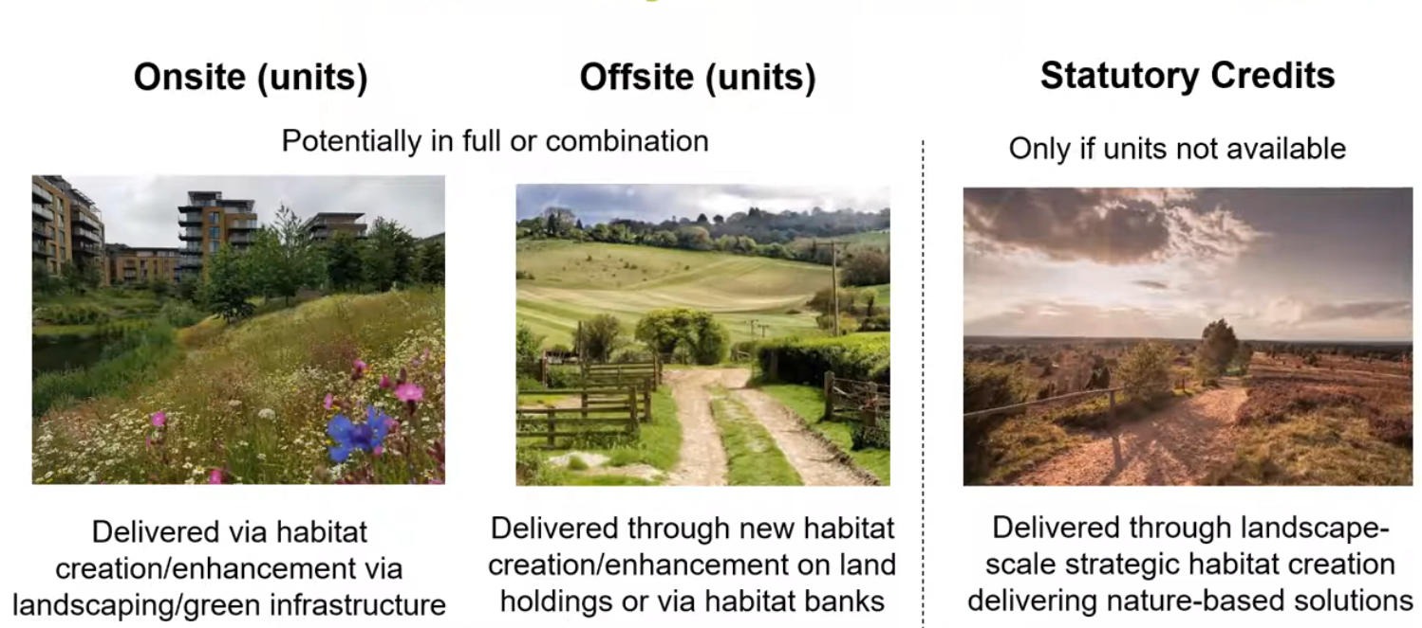
How will BNG be delivered?

Slide 33
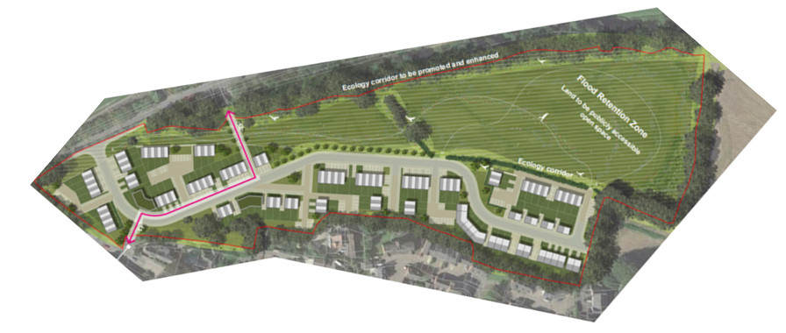
On-site
Provision of new biodiverse green space
Enhancement of existing features
Tree planting
New hedgerow planting
Retention of important habitats

Slide 34
Off-site

Slide 35
Off-site
Any site delivering ‘off-site’ biodiversity units must be registered on the Natural England ‘biodiversity gain site register’
  Each site will have a unique reference number that is tied to planning reference
  There biodiversity metric has built in measures to disincentive provision of off-site units outside of LPA boundaries
Registration requires legal commitments to create habitat enhancements and maintain them for at least 30 years after completion of the enhancements
  S106 or Conservation Covenant (TBC)

Slide 36
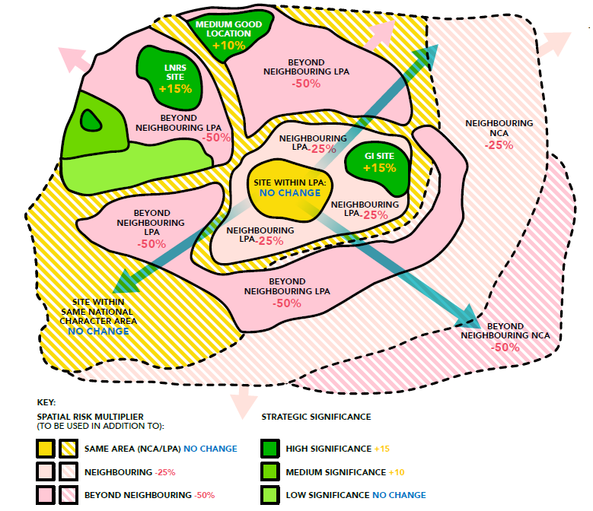
Off-site – spatial risk multiplier
Notes:
The Proximity Principle:
Biodiversity net gain follows the proximity principle or spatial hierarchy. This means that if biodiversity net gain (BNG) cannot be achieved on-site after consulting the mitigation hierarchy, off-site
opportunities should be identified, giving priority to local enhancements. Statutory credits may be purchased only as a final option.
The metric penalises proposals where the off-site habitats are far away from the site of impact. This is done to avoid reducing biodiversity in the local areas, recognising the importance of ecosystem services provided to the local community.
The spatial risk multiplier is used for off-site habitats outside the local planning authority area or the same National Character Area/Marine Plan Area for inter-tidal habitats. For rivers and streams,
WFD water body and catchment boundaries should be used. Apply the multiplier once, in line with the larger of the two designations the offsite enhancement is within, typically the National Character Area. If the off-site enhancement is in a neighbouring LPA but the same National Character Area, use the relevant NCA multiplier.

Slide 37
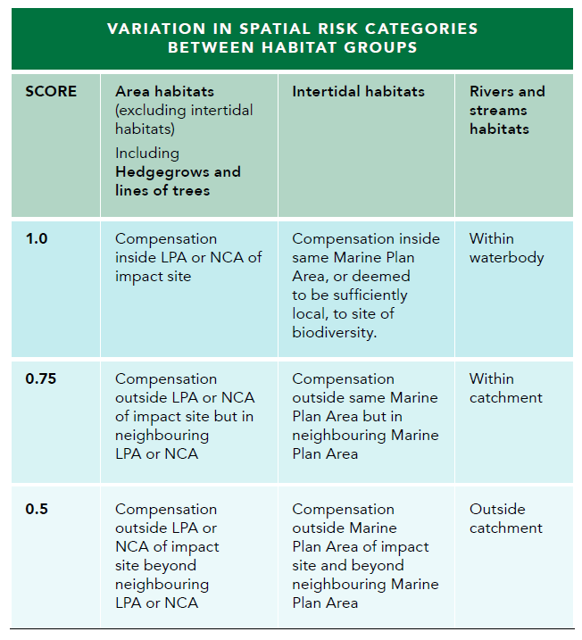
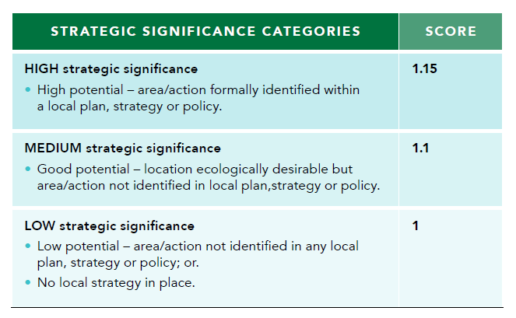
Off-site – spatial risk multiplier
Notes:
To align with local nature priorities, a multiplier is proposed and incentivised by the Biodiversity Metric’s strategic significance score, as seen in nature recovery networks. This would make use of published
local strategies that identify local priorities, such as:
■ Local Nature Recovery
Strategies
■ Local Biodiversity Plans
■ National Character Areas
Objectives
■ Local Planning Authority Local
Ecological Networks
■ Shoreline Management Plans
■ Estuary Strategies
■ Green Infrastructure Strategies
Multiplier scores apply across all pre- and post-intervention and on- and off-site calculations. This is based on the habitat type and its location, depending on their status in a local plan, strategy, or
policy. These apply to all habitats except rivers and streams. When either high or medium strategic significance is used the user should complete the ‘assessor comments’ section of the metric
calculation tool to justify why a habitat in a particular location warrants that level of strategic significance.
Medium strategic significance can be used where professional judgement is applied and the location is deemed ecologically desirable for a particular habitat type, whether recorded in the
site baseline, being created, or enhanced. Where professional judgement is applied in this way, the decision should be justified, and evidence provided ‘to the relevant local authority’ (determined in original legal
agreements).
Available datasets can be used to identify the relevance of a specific location for certain habitat types.

Slide 38
Small Sites Metric (SSM)
The Small Sites Metric (SSM) is a simplified version of the Biodiversity Metric 4.0.
It has been specifically been designed for use on small development sites where the project chooses to do so. Such sites are defined (for the purposes of this Small Sites Metric) as small sites where the following criteria are met:
For residential development:
  - there are fewer than 10 residential units on a site area (no more than 9 units) less than 1 hectare; or
  - if number of residential units is not known, the site area is less than 0.5 hectares
For non-residential development:
    where the floor space to be created is less than 1,000 square; or
    where the site area is less than 1 hectare

Slide 39
Small Sites Metric (SSM)
Biodiversity units are calculated using the size of a parcel of habitat and its quality
The SSM uses area (measured in m²) and length (measured in m)
The SSM cannot be used on such sites where:
  Habitats not available in the SSM are present
  Priority habitats are within the development site (excluding some hedgerows and arable field margins)
  European protected species are present on the development site, e.g., bats, dormice, otter, great crested newts
  Any offsite interventions are required

Slide 40
Small Sites Metric (SSM)
A competent person must carry out the habitat survey and complete the SSM calculation.
Users of the SSM should be competent in identifying:
  Habitats present on site (pre-development)
  Management requirements for habitats to be created or enhanced within the landscape design (post-development)
Competency is aligned with the British Standard ‘Process for designing and implementing biodiversity net gain: BS 8683:2021’
  Does not have to be an ‘ecologist’ but details must be provided as to the metric users competency
Notes:
The developer is responsible for selecting the competent person for completing the SSM. The competent person does not need to be an
ecologist for the SSM. The Local Planning Authority does not need to verify the competent person.
A competent person is someone who can demonstrate they have acquired through training, qualifications or experience, or a combination of these, the knowledge and skills enabling that person to perform specified tasks in completing and reviewing metric calculations.
Where required, evidence should be provided and be signposted within the ‘user comments’ section of the SSM

Slide 41
Statutory credits
Last resort – sold by the government on an online platform (TBC)
Deliberate high price as a disincentive
Money used by government for enhancement works or to buy land
Proof of purchase required within the Biodiversity Gain Plan
Likely to be phased out once the ‘off-site’ market is functioning

Slide 42
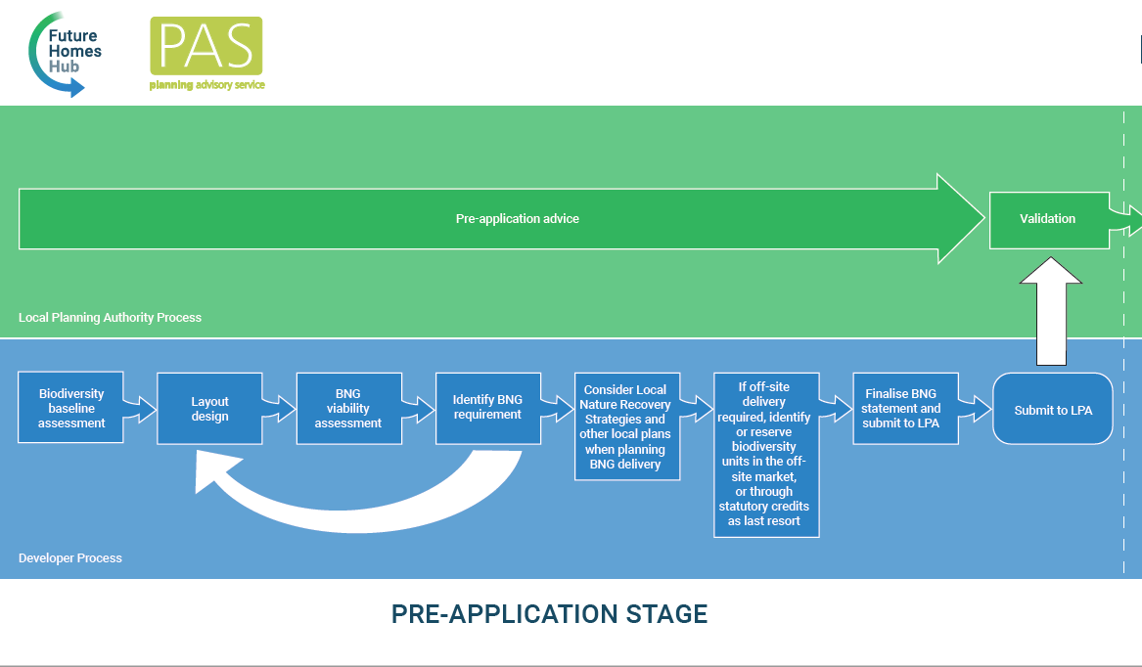
Example BNG workflow

Slide 43
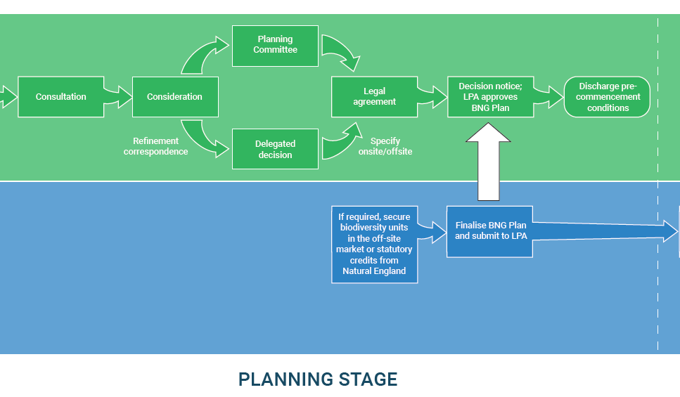
Example BNG workflow

Slide 44
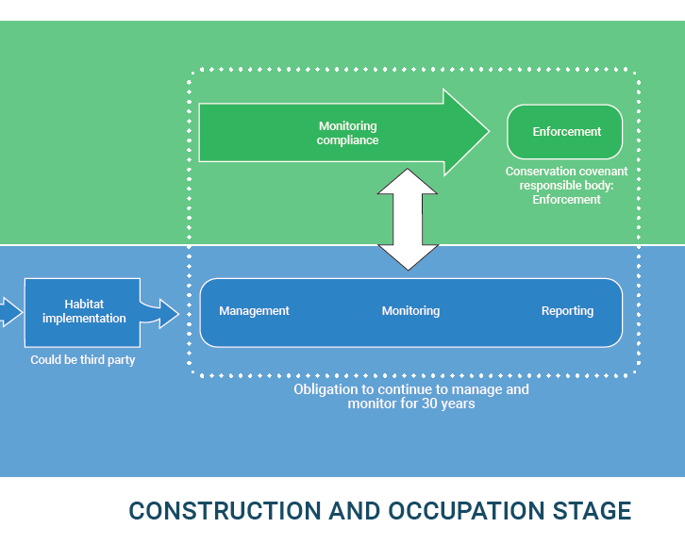
Example BNG workflow

Slide 45
Thank you – any questions?

Slide 46
Reference material
Biodiversity Net Gain 2022 consultation events | Local Government Association
UK Green Building Council ukgbc.org
Baker et al. (2019). Biodiversity net gain. Good practice principles for development.
CIEEM (2019). InPractice. Issue 104. Biodiversity Net Gain.
Natural England (2023). The Biodiversity Metric 4.0 User Guide.

