Slide 1
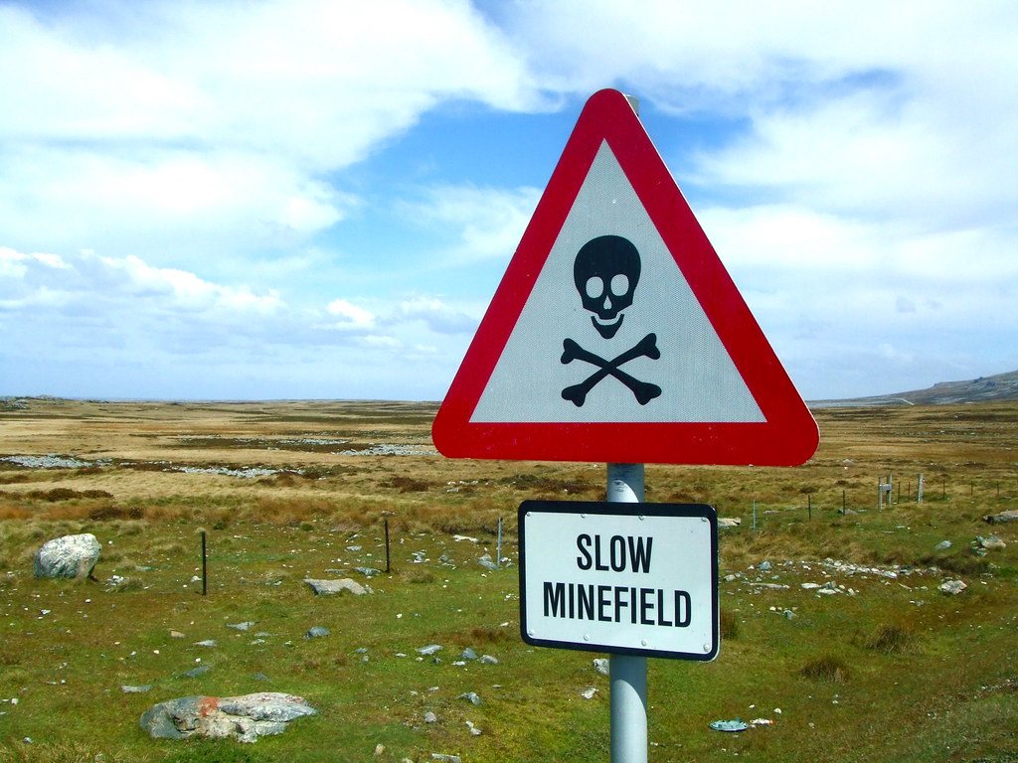

Successfully
Navigating
CIL
Agents Forum – June 2024
Jonathan Smith MRICS
Planning Obligations Team Leader

Slide 2


Successfully Navigating CIL: Our Promise
CIL is not about trying to extract as much money as possible-
we will apply the CIL Regs in a fair, consistent manner & provide advice & assistance throughout the process

Slide 3

Successfully Navigating CIL: Our Team
Jonathan Smith: Team Leader
Carolle House: CIL Officer
John Llewellyn: CIL Officer
George Paddon: Support Officer

Slide 4
Successfully Navigating CIL: Process
Submit CIL Additional Information Form with Full or Reserved Matters application
(The completed form is required to make the application valid).
Submit commencement notice to inform when development will commence. This is in addition to notifying building control on the commencement of works.
The application is checked and validated.
Demand notice is issued for CIL payment.
Submit Assumption of Liability Form and any relevant exemption form before determination of planning permission.
CIL is paid in line with payment procedure.
Receipt for payment is issued and local land charge is removed.
Application is determined, liability calculated and liability notice is sent to the parties who have assumed liability (and/or landowners if nobody has assumed liability). Liability notice is registered as a local land charge.
Blue = Applicant
Red = EDDC

Slide 5
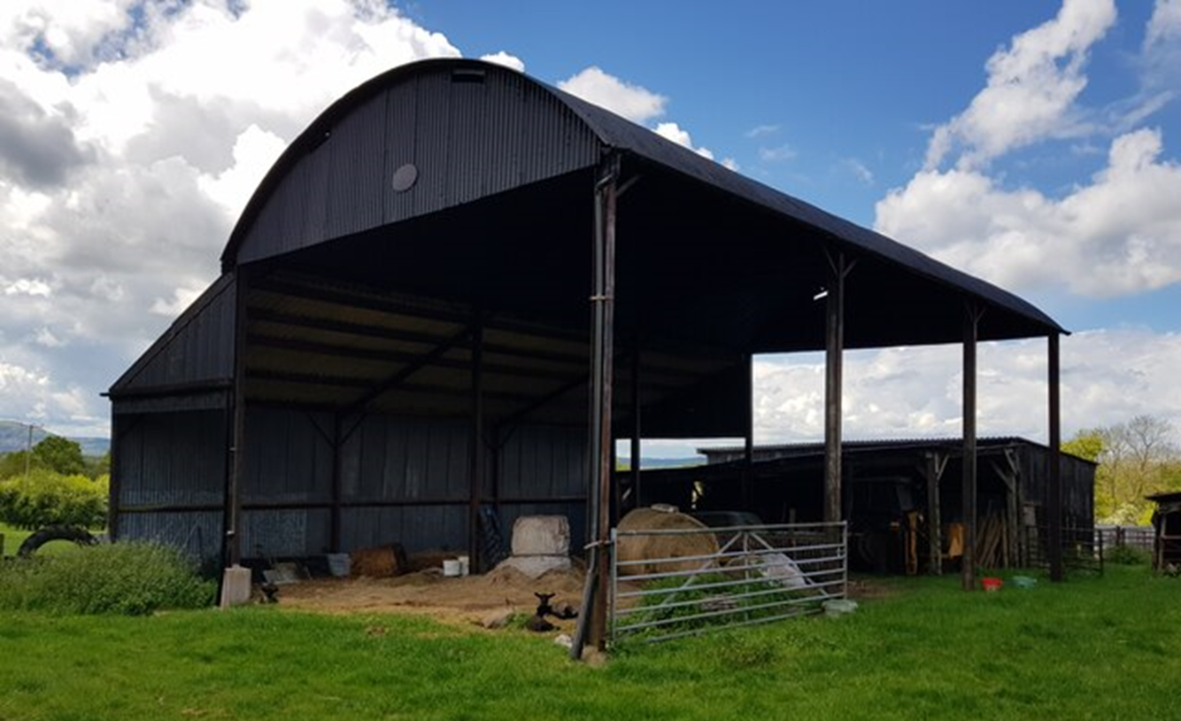
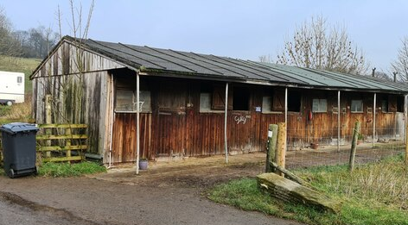
Successfully Navigating CIL: Area Offsets
Chargeable Amount based on gross internal area of development
Floor area of demolished buildings or conversion can be deducted
Must be in continuous lawful use 6 mths in 3 years prior to consent
Onus is on applicant to evidence lawful use
Evidence should be gathered prior to consent & could be:
copies of leases
utility bills
council tax bills
redacted bank statements for rent payments
affidavit
This Photo by Unknown Author is licensed under CC BY-SA

Slide 6

Successfully Navigating CIL: Self-Build Exemptions
Self-build must be dwelling built or commissioned for own occupation
Exemption must be sought before commencement of development
On completion, supporting evidence required
Must be principal residence for 3 years
4 step process:
  Assumption of liability (Form 2)
  Self-certification of self-build (Form 7 Pt1)
  Commencement Notice prior to start on site (Form 6)
  Self-Build Exemption Claim (Form 7 Pt2) within 6 months of completion including evidence
Suitable Evidence of Self-Build:
Proof of completion date, ownership & occupation
VAT reclaim or Self-Build Warranty or Self-Build Mortgage
Other evidence can be accepted at LAs discretion but must be agreed at Pt1 or Pt2 at the latest
Disqualifying Events:
  Failure to comply with evidence requirements, letting or disposal within 3-year occupancy period

Slide 7

Successfully Navigating CIL: Annexes & Extensions
CIL regs 42A &42B
CIL Form 8 annexe or 9 extension (submit before PP)
Main dwelling must be principal residence
Must have material interest (FH or LH 7yrs+)
Extensions exempt if main residence is enlarged & doesn’t comprise new dwelling
Annexe exempt if built within curtilage of principal residence
Occupier of annexe does not have to be related or stay for specified period
No letting or disposal within 3 yrs of compliance certificate
Extensions under 100sqm exempt as ‘minor development’ (provided separate dwelling not created)

Slide 8

Successfully Navigating CIL: Appeals
S113: Liability Notice can be reviewed by LA within 14 days of issue- LA must respond within 14 days- appeal to VOA within 60 days
S114-116: appeals relating to chargeable amount, apportionment of liability, charitable relief, annexe, extension or self-build exemptions to VOA
S117-119: appeals relating to enforcement (surcharges, commencement, stop notices) to PINs

Slide 9

Successfully Navigating CIL: Core Principles
The onus is on the applicant to engage with the CIL process throughout
Keep LA informed at each milestone- don’t assume we talk to each other within the Council!
Failure to do so could result in disqualification for exemptions, surcharges and interest payments

Slide 10

Successfully Navigating CIL: Questions

