Slide 1
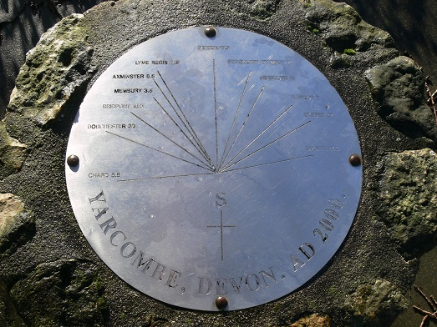

Slide 2
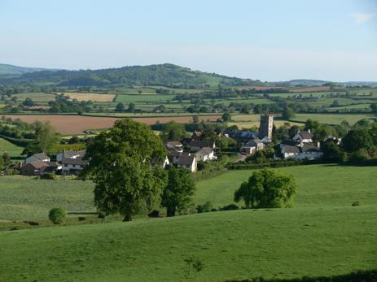
Yarcombe and Marsh
Neighbourhood Plan

Slide 3
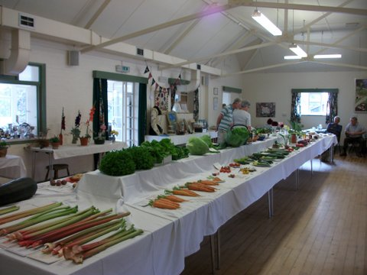
Questions and Answers
What is a Neighbourhood Plan?
Why are we doing one?
Who is doing it?
Where have we got to?
What are we doing now?
When will it be finished?

Slide 4
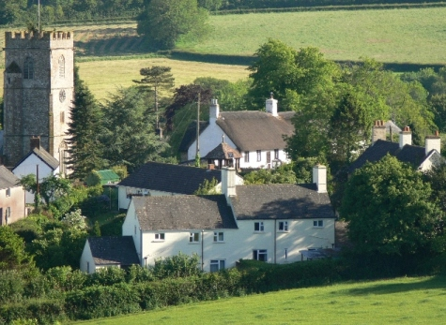
What is a Neighbourhood Plan?
Plan for the Parish
Gives community direct power to develop a shared vision for their area and shape its development and growth.
Helps determine where new homes, shops and employment buildings are built, and what they look like.
Tool for local people to ensure that they get the right types of development for their community.
Synchronised with the Local Plan to provide planning guidance for the area.
Notes:
100 Communities doing one

Slide 5
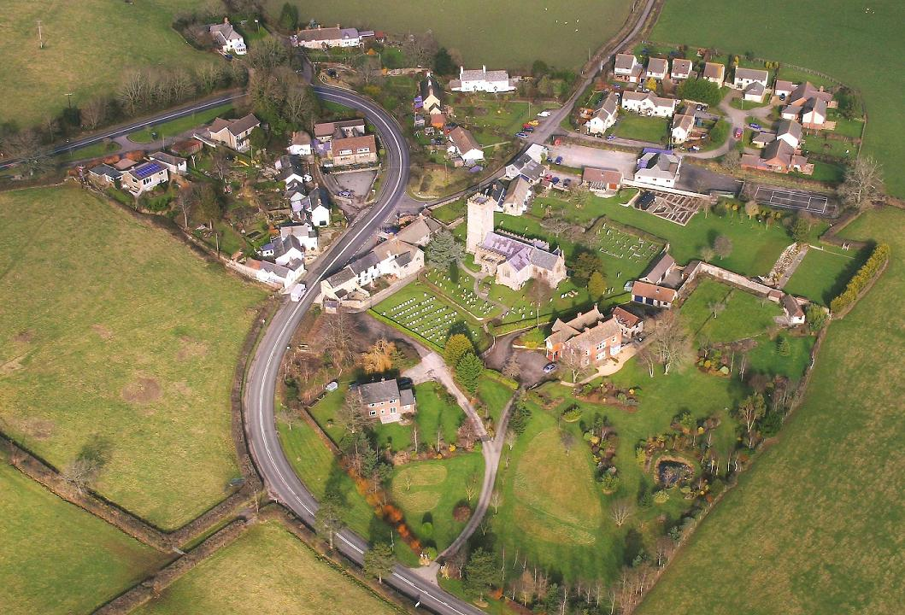
Why are we doing one?
Yarcombe has been seen as “unsustainable”
Need to have an exception site for affordable housing.
Parish Council concern for many years that District planning policy did not always recognise specific local needs.

Slide 6
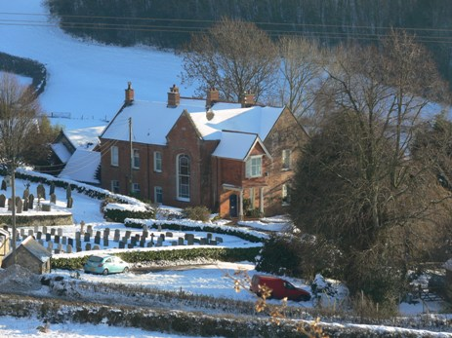
Who is doing it?
Parish Council managed project
Funded by Central Government
Supported by Planning Consultants
Neighbourhood plan committee
  Lesley Pidgeon
  Tony Long
  Lesley Sutton
  Graham Wadey
  Nick Randle ( chairman)
  Wendy Randle ( secretary)
Notes:
Planning Conslultants
Advised on Process
Produced remplates
Produced written evidence base
£7000 from Central Govt
2,000 from EDDC
7500 spent

Slide 7
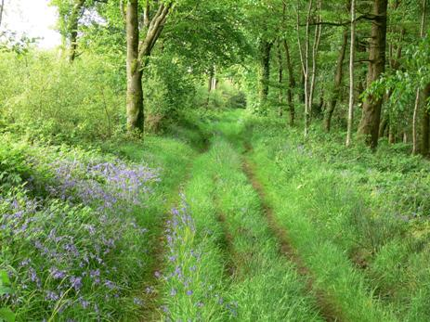
Where have we got to?
Community Consultation
  Survey
  Exhibition
  Young people’s event
Consultation with Local and National Groups
Analysis of results
Community Feedback ,
  Flyer in Yarcombe Voices
  Exhibition
Drafting aims and objectives
Drafting plan report

Slide 8
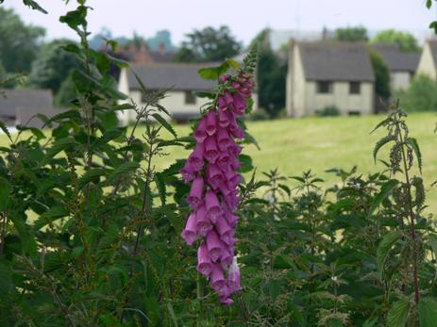
What are we doing now?
Report Drafting
  Introduction- Lesley Sutton
  Population and Housing- Lesley Pidgeon
  Built and Historic Environment- Tony Long
  Energy and Low carbon Alternatives- Graham Wadey
  Natural Environment- Graham Wadey
  Economy and employment- Nick Randle
  Transport and accessibility- Nick Randle
  Community facilities and services- Wendy Randle
Notes:
Thanks to the committee and especially to Wendy

Slide 9

When will it be finished?
Report Drafted and published for Comment- July/Aug
Final Plan submitted to EDDC- Sept /Oct
Independent Examiner Oct/ Nov
Local Referendum
Adoption of Neighbourhood Plan
Notes:
Step 1: Designating neighbourhood area and if appropriate neighbourhood forum
Relevant body (parish / town council, prospective neighbourhood forum or community organisation) submits an application to the local planning authority (LPA) to designate a neighbourhood area
local planning authority publicises and consults on the area application for minimum 6 weeks (or minimum of 4 weeks where the area to which the application relates is the whole of the area of a parish council and is wholly within the area of one local planning authority)
local planning authority designates a neighbourhood area within the statutory timescales
In an area without a town or parish council a prospective neighbourhood forum submits an application to be the designated neighbourhood forum for a neighbourhood area
local planning authority publicises and consults on the forum application for minimum 6 weeks
local planning authority takes decision on whether to designate the neighbourhood forum
Step 2: Preparing a draft neighbourhood plan or Order
Qualifying body develops proposals (advised or assisted by the local planning authority)
gather baseline information and evidence
engage and consult those living and working in the neighbourhood area and those with an interest in or affected by the proposals (e.g. service providers)
talk to land owners and the development industry
identify and assess options
determine whether a plan or an Order is likely to have significant environmental effect
start to prepare proposals documents e.g. basic conditions statement
Step 3: Pre-submission publicity & consultation
The qualifying body:
publicises the draft plan or Order and invites representations
consults the consultation bodies as appropriate
sends a copy of the draft plan or Order to the local planning authority
where European Obligations apply, complies with relevant publicity and consultation requirements
considers consultation responses and amends plan / Order if appropriate
prepares consultation statement and other proposal documents
Step 4: Submission of a neighbourhood plan or Order proposal to the local planning authority
Qualifying body submits the plan or Order proposal to the local planning authority
Local planning authority checks that submitted proposal complies with all relevant legislation
If the local planning authority finds that the plan or order meets the legal requirements it:
publicises the proposal for minimum 6 weeks and invites representations
notifies consultation bodies referred to in the consultation statement
appoints an independent examiner (with the agreement of the qualifying body)
Step 5: Independent Examination
local planning authority sends plan / Order proposal and representation to the independent examiner
independent examiner undertakes examination
independent examiner issues a report to the local planning authority and qualifying body
local planning authority publishes report
local planning authority considers report and reaches own view (save in respect of community right to build orders where the report is binding)
local planning authority takes the decision on whether to send the plan / Order to referendum
Steps 6 and 7: Referendum and Making the neighbourhood plan or Order (bringing it into force)
relevant council publishes information statement
relevant council publishes notice of referendum/s
polling takes place (in a business area an additional referendum is held)
results declared
subject to results local planning authority considers plan / order in relation to EU obligations and Convention rights
If the plan / Order is compatible with EU obligations and does not breach Convention rights – local planning authority makes the plan or Order.

